Slide 1

Car Remarketing
Project Guide:Krunal Sarvaiya
Prepared By: Rahul Sata
Pawan Kumar
Rohan
Hafiza
Daksh S Patel
Kajol Patel

Slide 2
Content
Project Definition
Project Plan
Software and Hardware requirements
Functional and Non-Functional requirements
Data Dictionary
UML Diagrams
UI Design
Future Work
Conclusion
Bibliography

Slide 3
Car Remarketing
Car remarketing is web based application built for the car leasing company.
In European countries there is a practice of leasing a car for long period of time instead of buying it.
So this web application is intended to serve that problem by providing an interface for the company as well as the user or customer.

Slide 4
Project Plan
Design Models and Mockups.
Developing NFP
Development Sprint
Testing

Slide 5
Software Requirements
Visual Studio Code
Microsoft Visual Studio 2017
SSMS
Microsoft .NET Framework 4.0

Slide 6
Hardware Requirements
Windows 7, Windows Server 2008 or higher
4 GB of RAM recommended
1.8 GHz or faster processor. Dual-core or better recommended
SQL Server requires a minimum of 6 GB of available hard-disk space.

Slide 7
Functional Requirements
View all available rental cars.
Search for desired car by model, seating capacity, and cost.
Select their desired rental car .
Allow the customer to log in.
Allow administrators to change what cars are available for rent/lease/Direct Purchase

Slide 8
Functional Requirements
Send an email to send quote.
Allow the user select and provide a payment type.
Select length of rental and planned drop-off date.
Calculate tax rates, customer totals.
Keep and display a wishlist of cars selected by user.

Slide 9
Non-Functional Requirements
Easy to use
Safe and secure
High Performance and Quick response time
GDPR

Slide 10
Data Dictionary

Slide 11
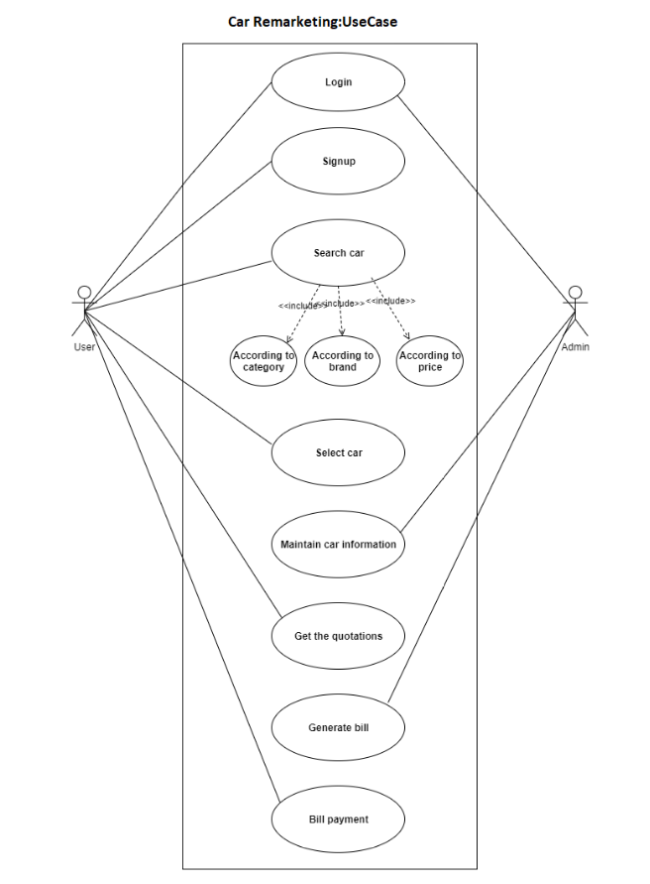
Use Case Diagram

Slide 12
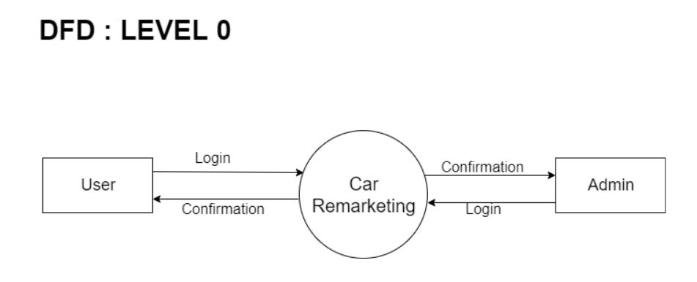
Data Flow Diagram

Slide 13
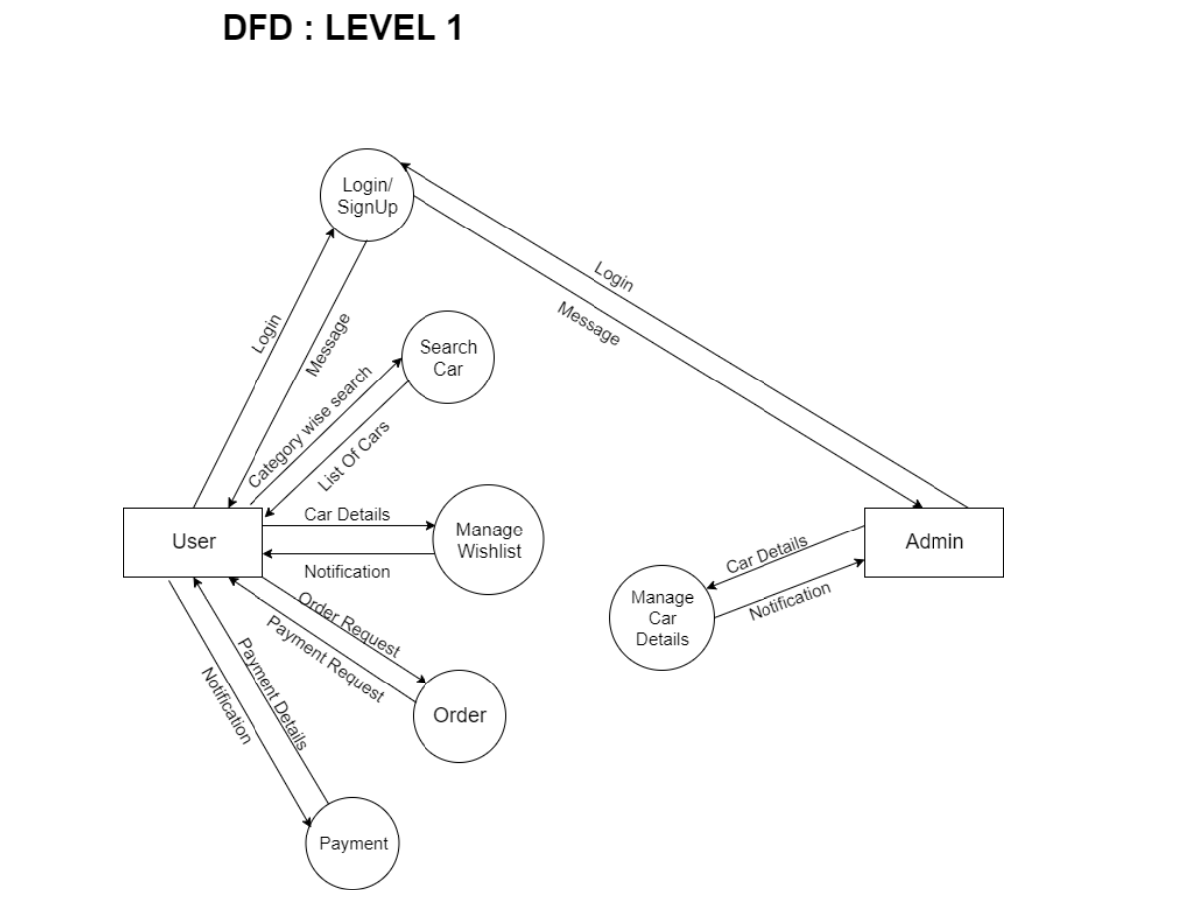

Slide 14
UI Design

Slide 15
UI Design

Slide 16
UI Design

Slide 17
Future Work

Slide 18
Bibliography
https://docs.microsoft.com/en-us/aspnet/mvc/
https://docs.microsoft.com/en-us/sql/sql-server/?view=sql-server-ver15
https://docs.microsoft.com/en-us/dotnet/csharp/programming-guide/concepts/linq/
https://www.telerik.com/documentation
https://getbootstrap.com/docs/4.4/getting-started/introduction/

Slide 19
THANK YOU !!!!

